Slide 1


Slide 2
Table of contents
1
Introduction
2
Sketching
3
Selected interface & rationale
4
Low-fi prototype (tasks + complete)
5
Testing methodology
6
Testing results
7
Discussions

Slide 3


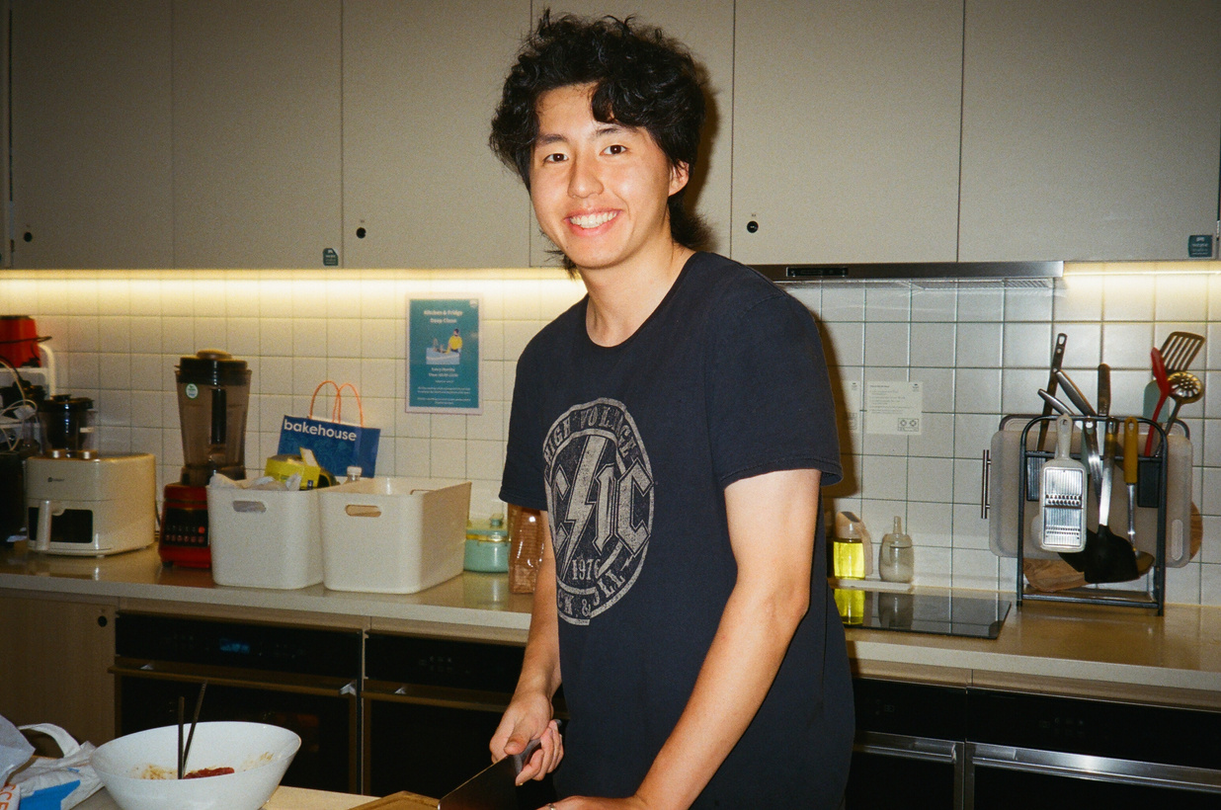

Meet the team
Sally
Steve
Zijian
Eric
Economics ‘25
Hong Kong
CS ‘25
California
Symsys ‘26
Chengdu, China
CS ‘24
California

Slide 4
Value Proposition
College mentorship reimagined with freedom and purpose

Slide 5
Problem & solution
Problem you are tackling:
Counselors lack independence when choosing students they want to work with (and topics) as they often work under a centralized topic
Our Primary User:
College Counselors
Brief synopsis of your proposed solution:
An app to allow Counselors to choose to work with small groups of students with interests and backgrounds that cater to their own knowledge.

Slide 6
3 Diverse
Realizations

Slide 7
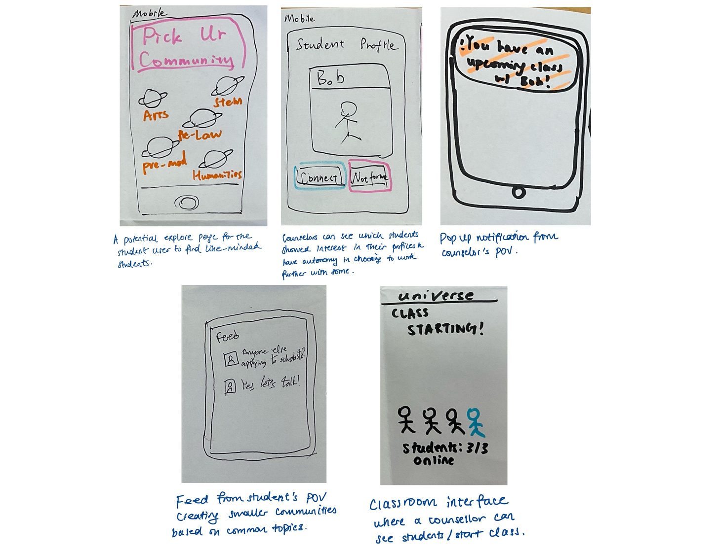
Diverse Realization #1 - Mobile

Slide 8
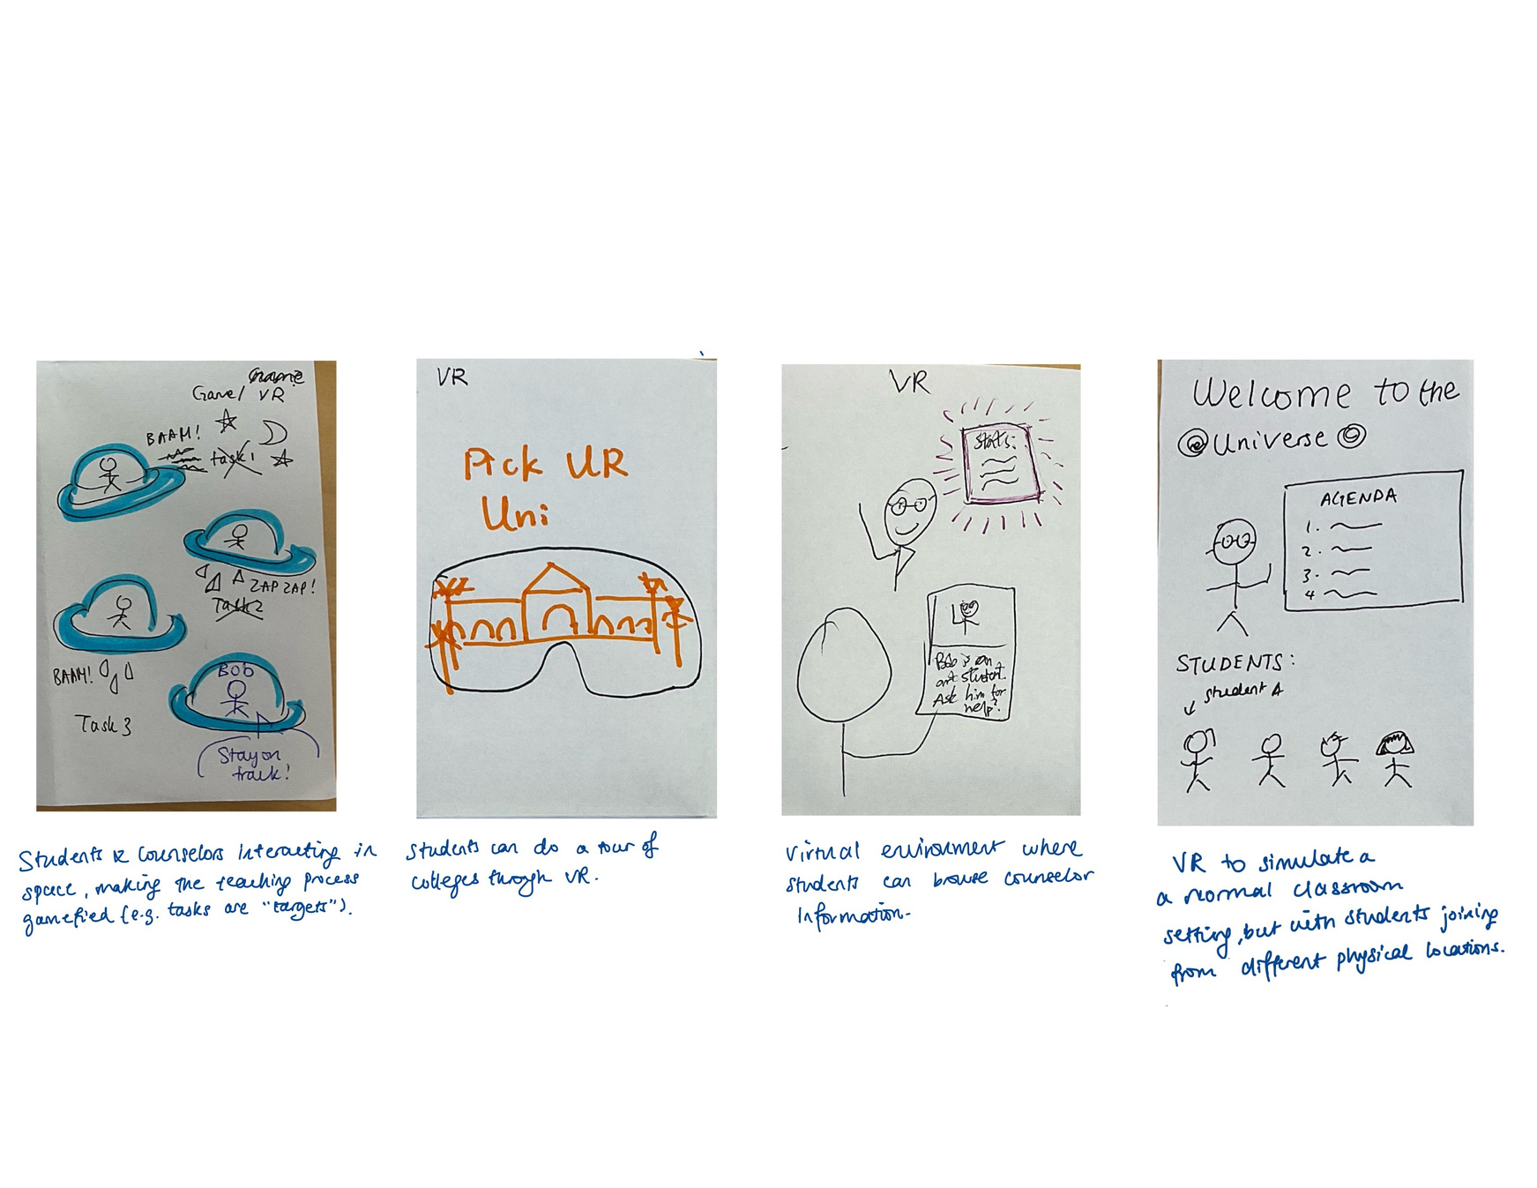
Diverse Realization #2 - VR

Slide 9
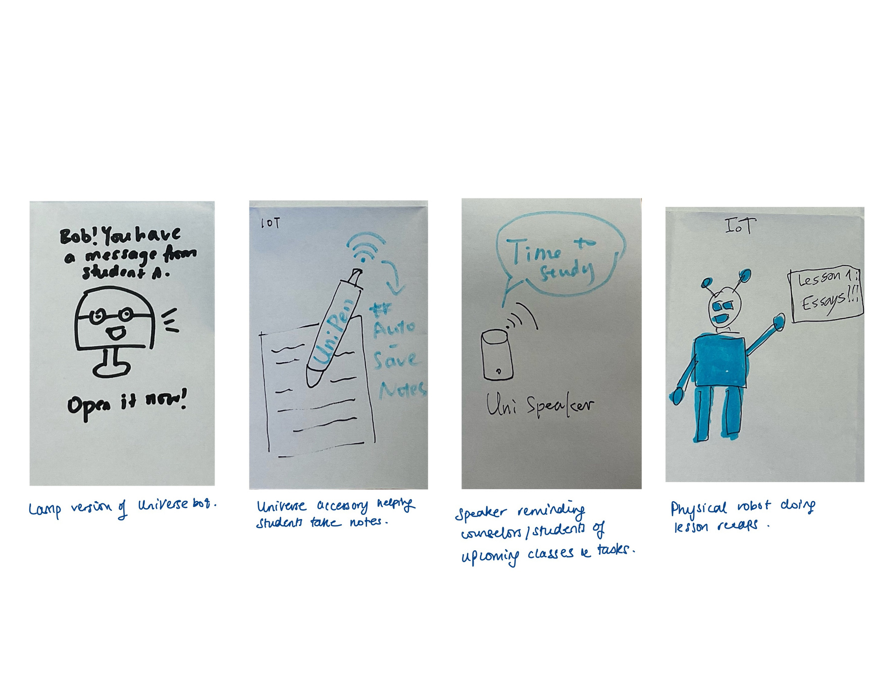
Diverse Realization #3 - IOT

Slide 10
Top 2 Realizations

Slide 11
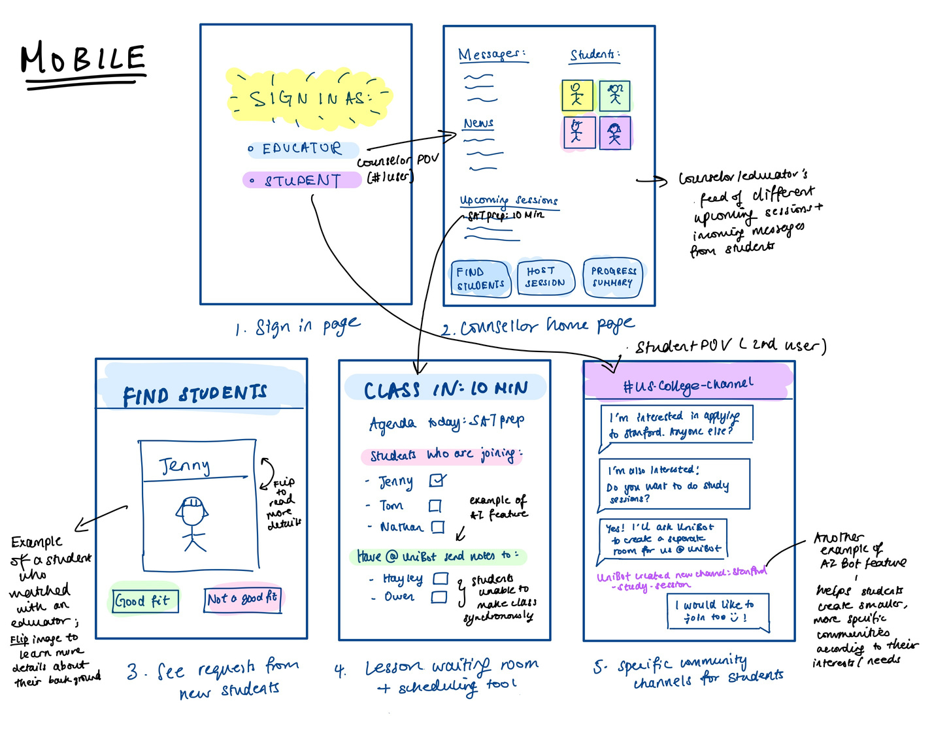
Top Realization #1 - Mobile

Slide 12
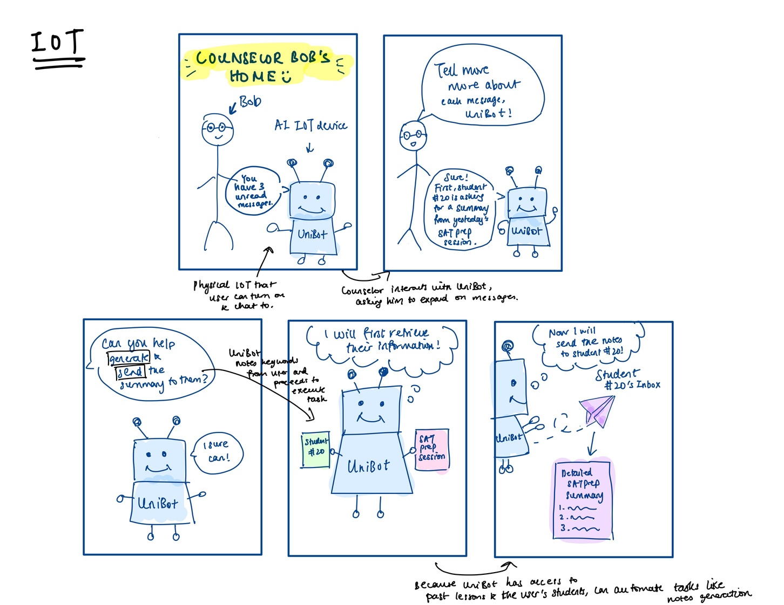
Top Realization #2 - IOT

Slide 13

Pros and Cons:
IOT
MOBILE
PROS:
CONS:
PROS:
CONS:
MORE ENGAGING
PROVIDES MORE USEFUL DATA
REQUIRES DEVICES MANY PEOPLE MAY NOT HAVE
EASY TO NAVIGATE
SIMPLE INTERFACE
INTUITIVE
MORE WORK TO ACCESS

Slide 14
Task Flows

Slide 15
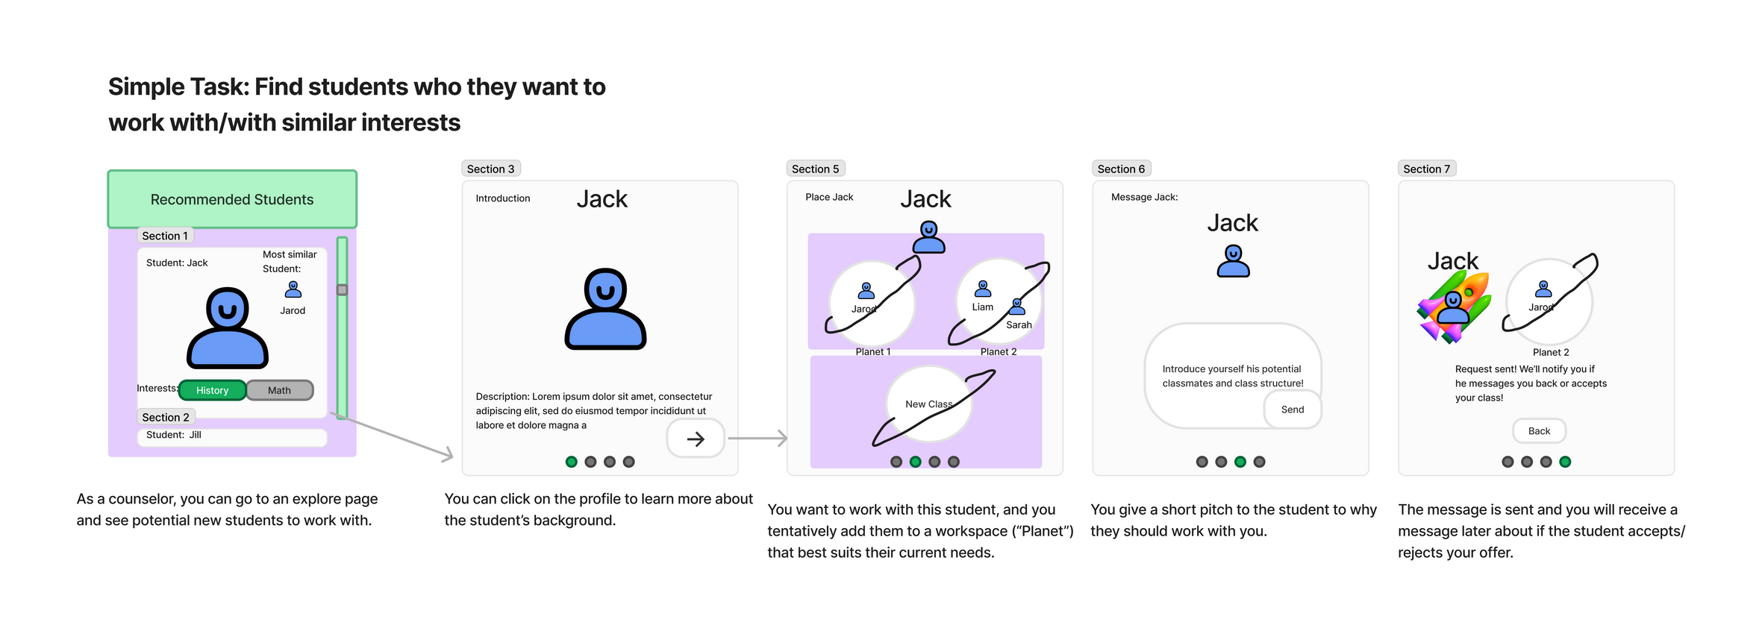
Simple Task Flow

Slide 16
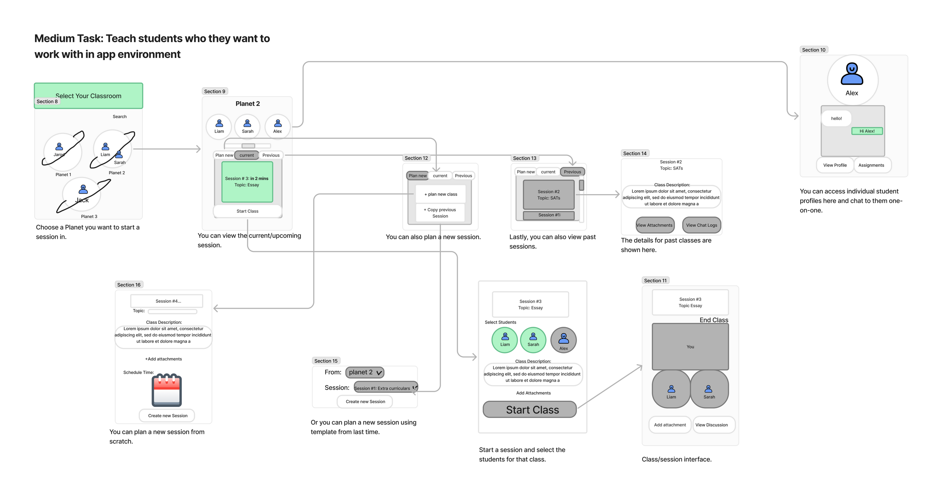
Medium Task Flow

Slide 17
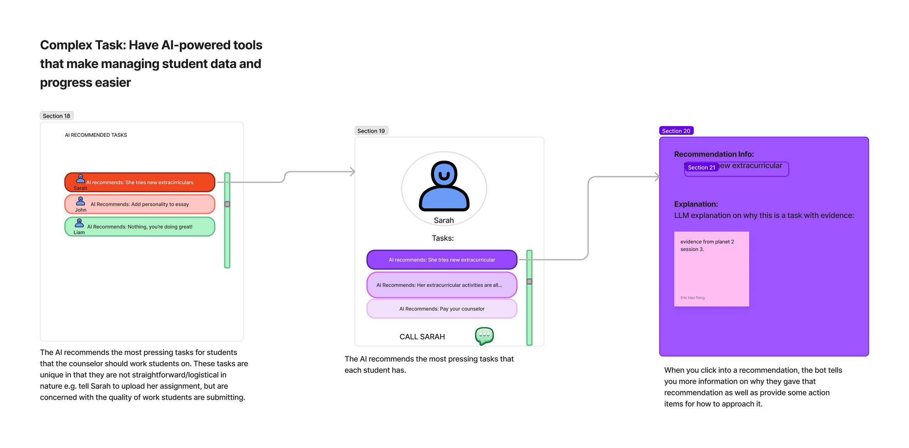
Complex Task Flow

Slide 18
Low Fidelity Paper Prototype

Slide 19
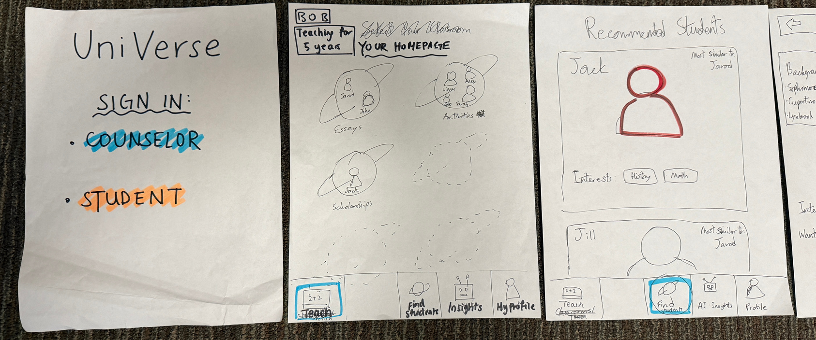
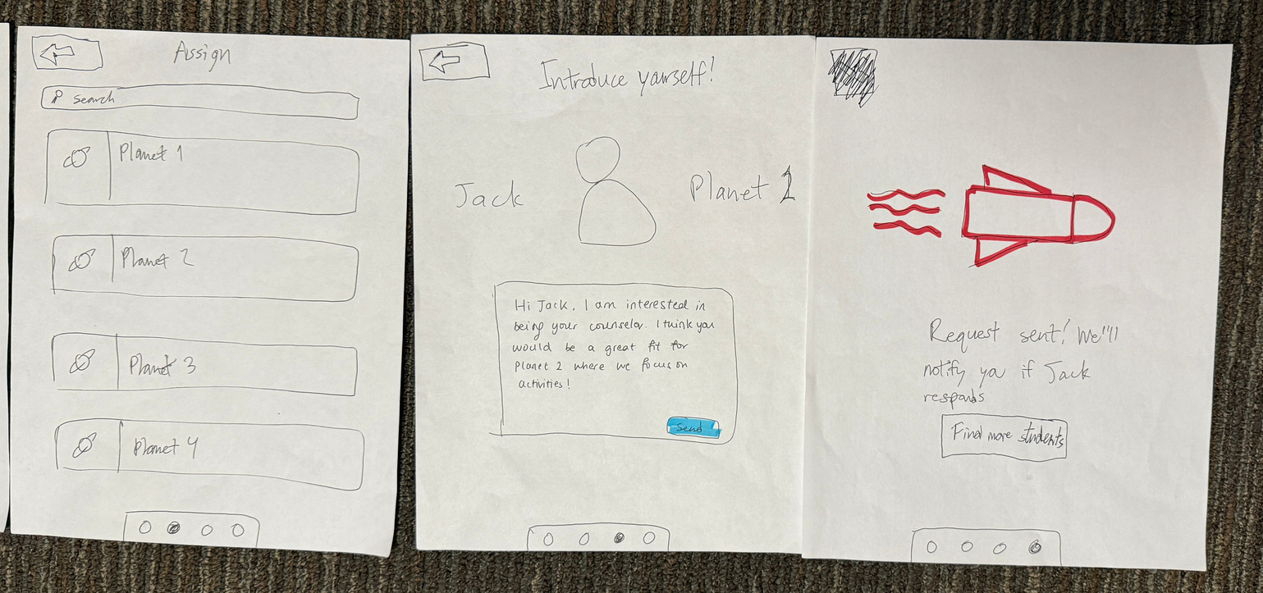
Simple Task Paper Prototype Version

Slide 20
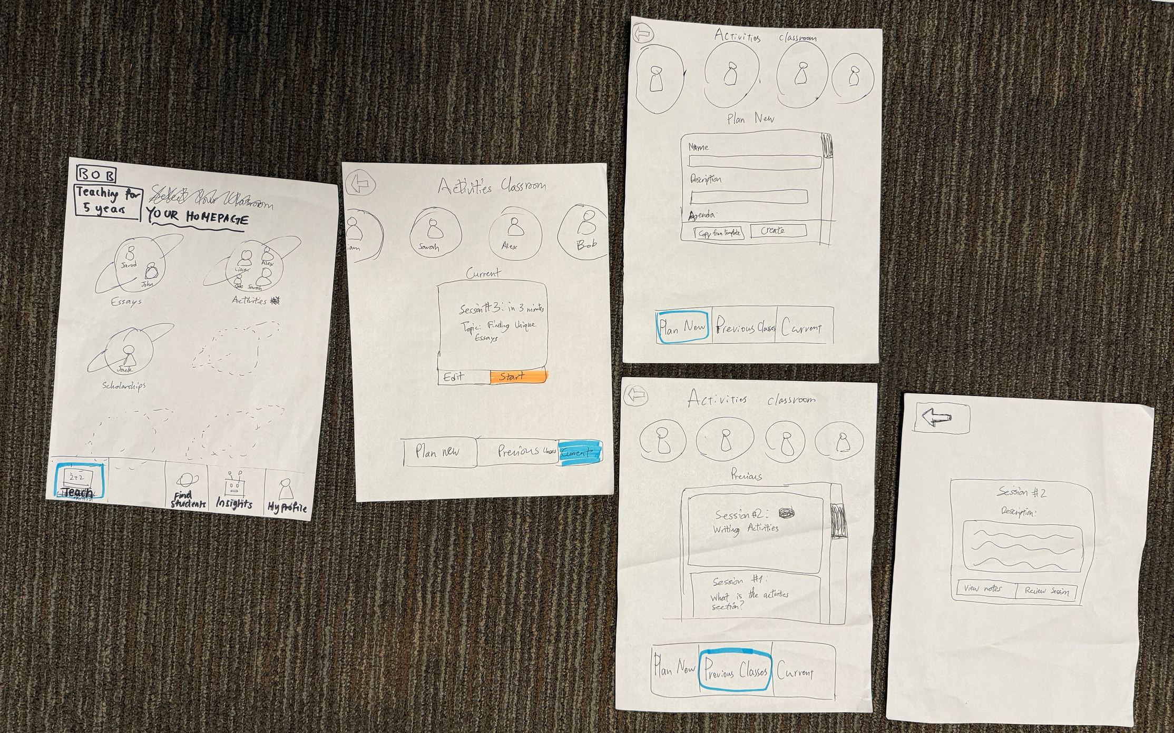
Medium Task Paper Prototype Version

Slide 21
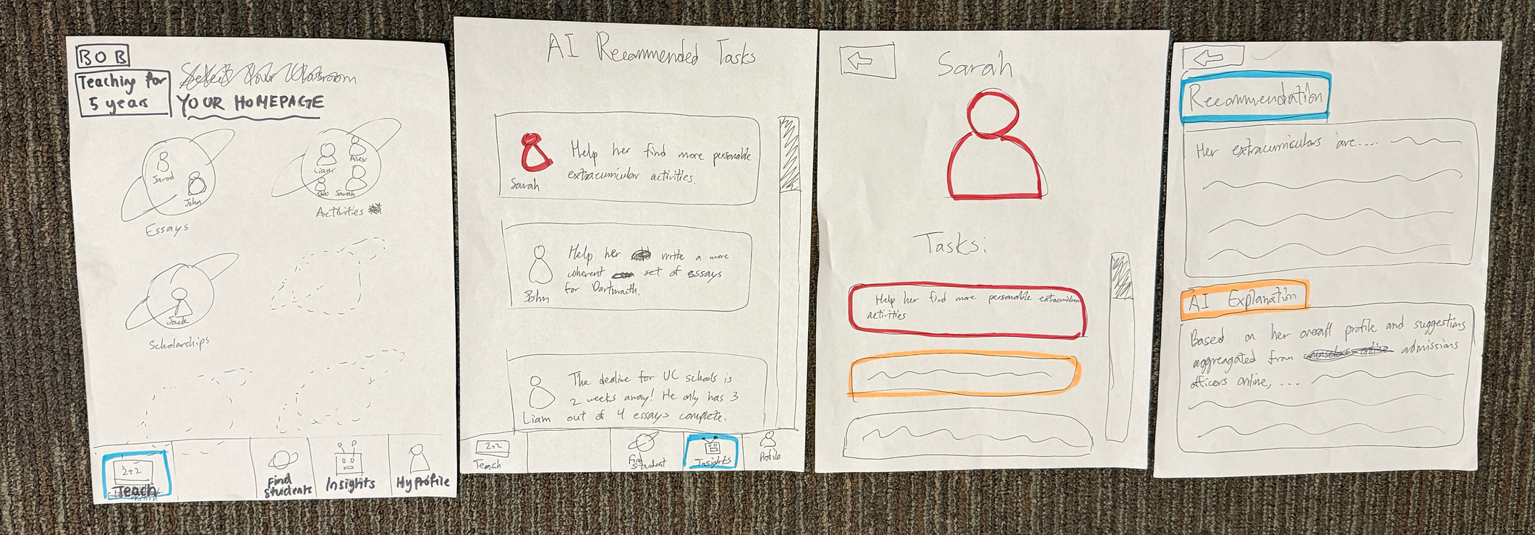
Complex Task Flow Paper Prototype
(Note: Although this is shorter, it’s complex because it’s something only a few power users might use.)

Slide 22
Methodology

Slide 23
Roles
Sally
Steve
Zijian
Eric
Observer/note-taker
Computer
Facilitator
Metrics recorder

Slide 24
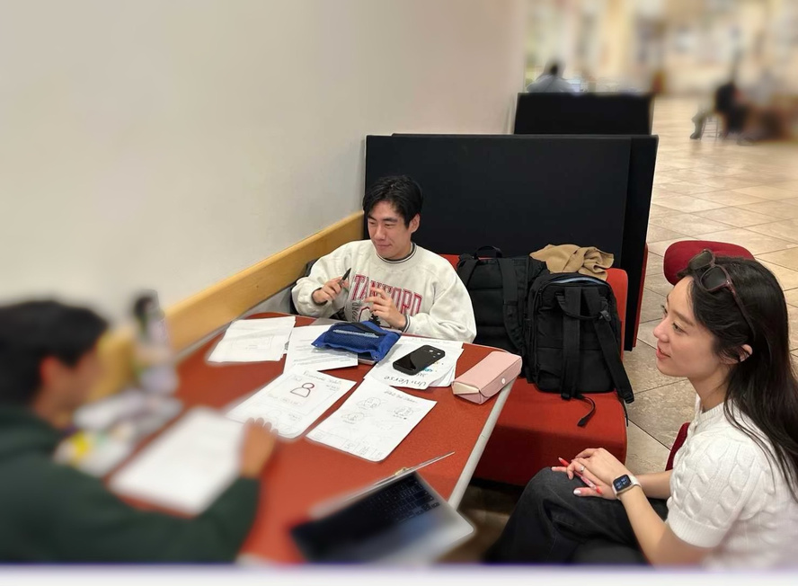
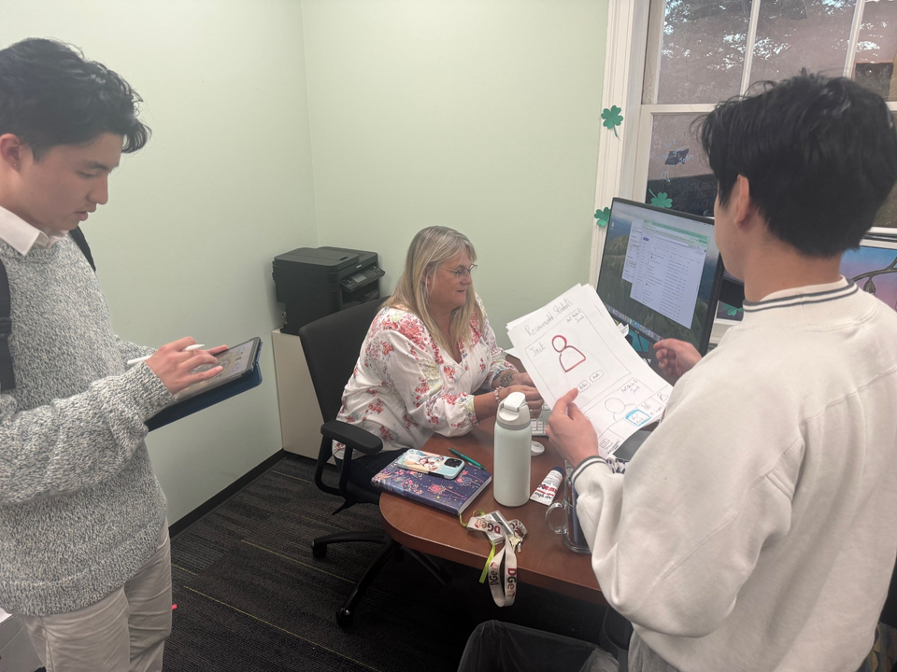
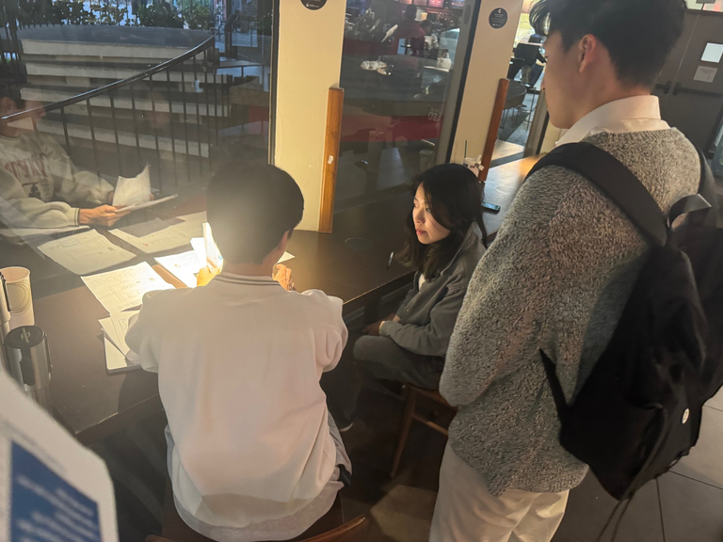
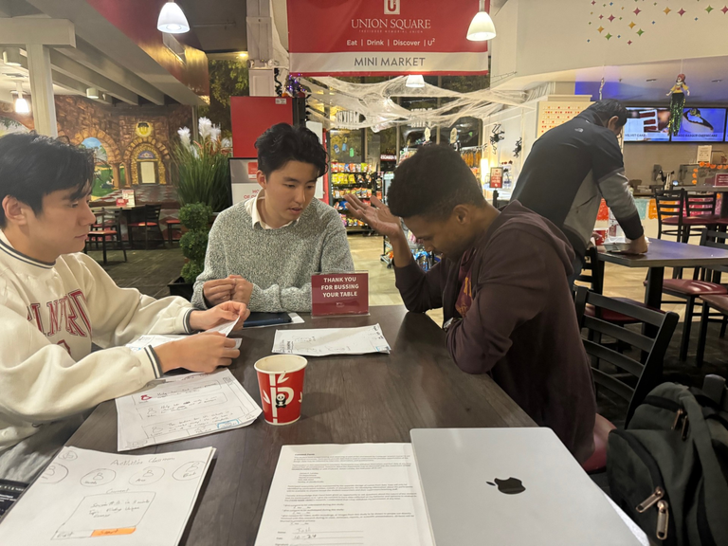
Participants:
PARTICIPANT 1:
PARTICIPANT 2:
PARTICIPANT 3:
PARTICIPANT 4:
Demographic: Non-Stanford student
Recruitment: Direct approach
Compensation: A Starbucks Coffee
Demographic: FLI Student counselor
Recruitment: Direct approach
Compensation: n/a
Demographic: Early Career Educator
Recruitment: Mutual Friend
Compensation: A Starbucks Coffee
Demographic: Data Scientist
Recruitment: Direct Approach
compensation: A Starbucks Coffee

Slide 25
Results

Slide 26

Usability goal metrics
Amount of time spent to complete a task
Amount of times a tester used the “back” button for each task

Slide 27
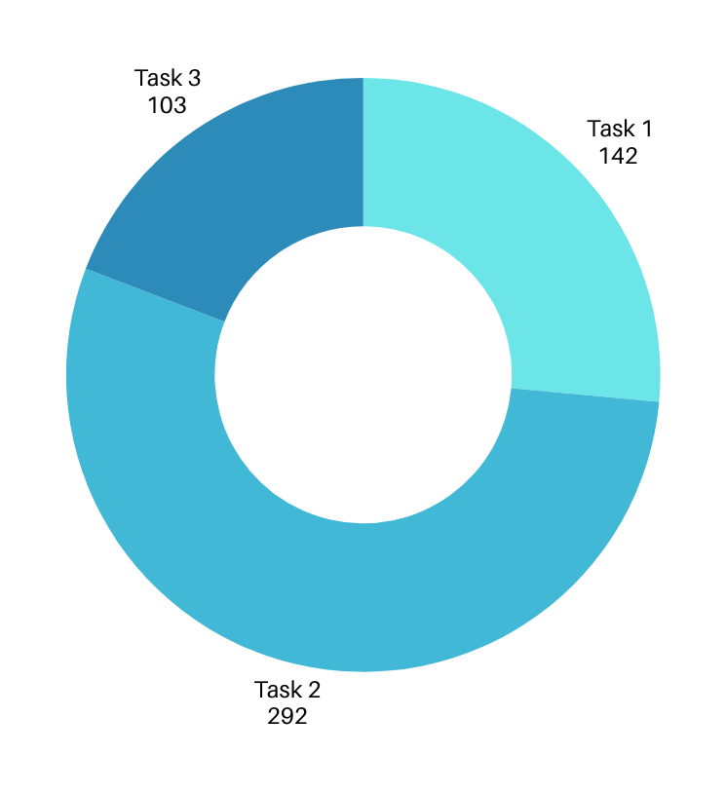
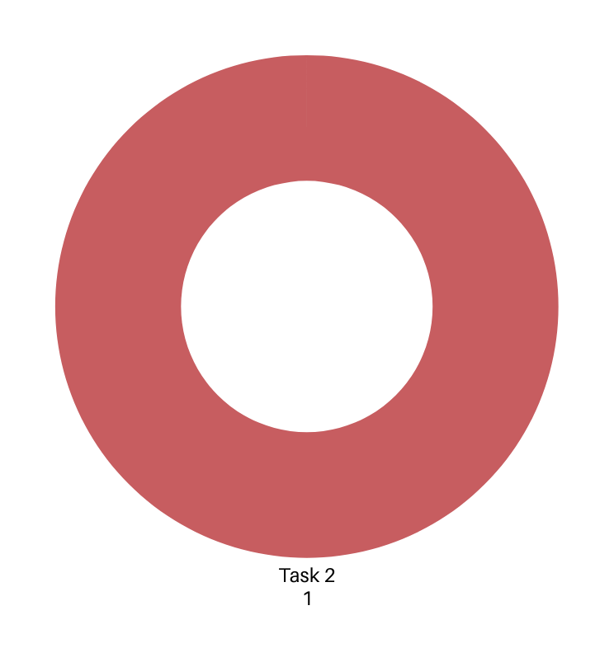
Participant1:
BACK PRESSES ON TASK
AMOUNT OF SECONDS ON TASK

Slide 28
Participant 1
This participant finished the testing process very smoothly without making many mistakes.
“The concept of a planet is a bit confusing”
“I don’t really understand what are the previous session information used for.”

Slide 29

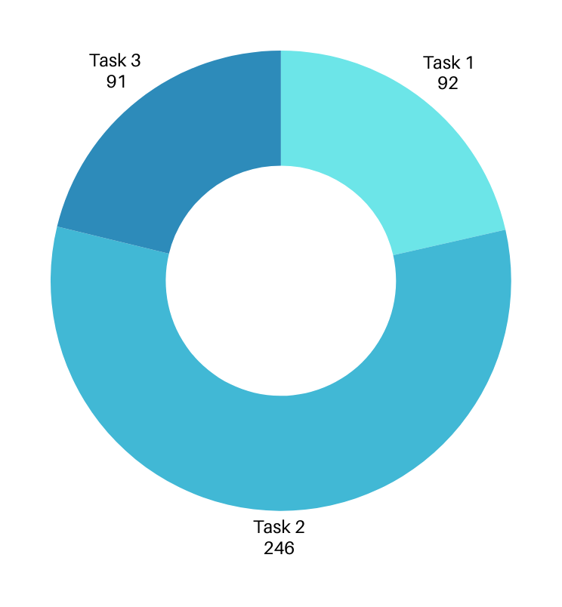
Participant 2:
BACK PRESSES ON TASK
AMOUNT OF SECONDS ON TASK

Slide 30
Participant 2
Understood the simple task easily.
More sensitive to text than visuals (icons/highlights)
“I wish there are error messages when I click on the wrong things.”
Was confused about the concept of assigning students to a planet.

Slide 31
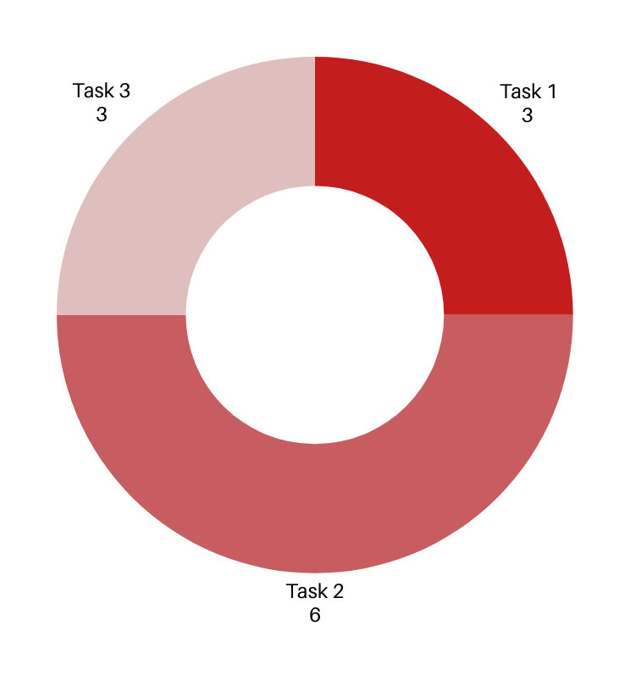
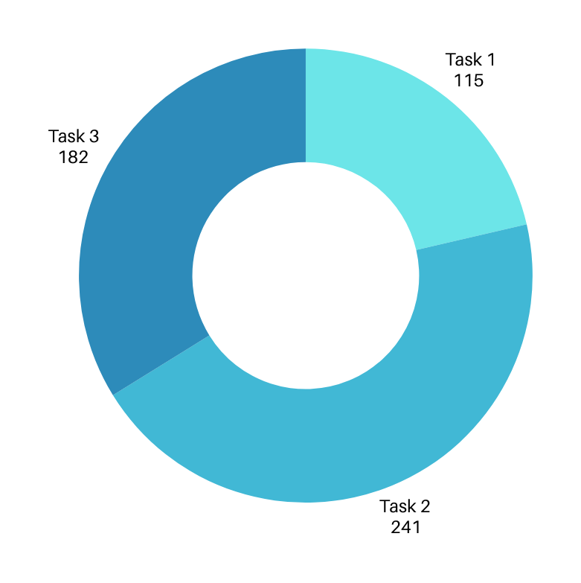
Parcipant 3:
BACK PRESSES ON TASK
AMOUNT OF SECONDS ON TASK

Slide 32
Participant 3
Was a bit confused with finding students in the simple tasks, but eventually achieved the task after some prompting
For the medium task, asked “what does recommended students mean?”
Associated it with recommendation letters
For the complex task, asked “what is the source of AI insights?”

Slide 33
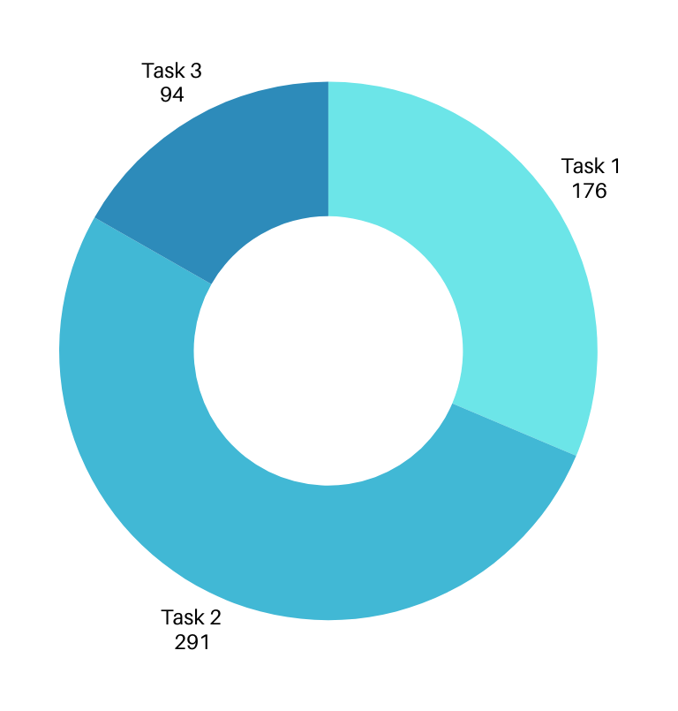
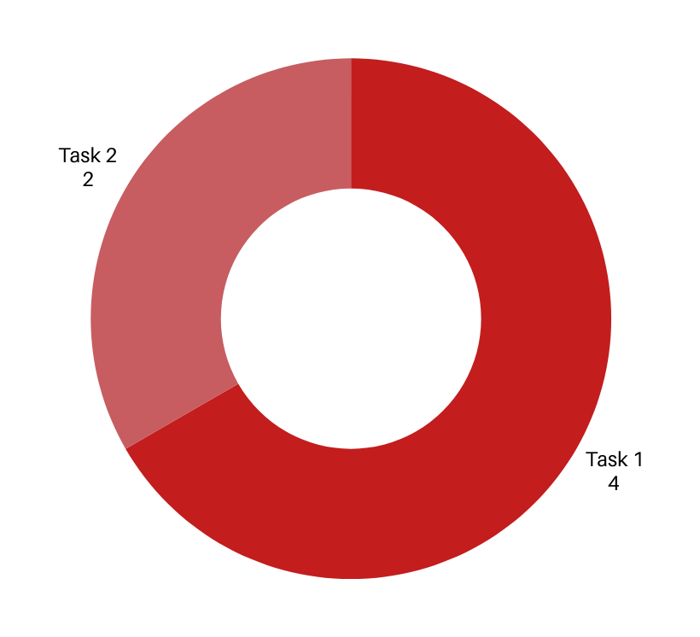
participant 4:
BACK PRESSES ON TASK
AMOUNT OF SECONDS ON TASK

Slide 34
Due to having worked professionally for a couple of years in the Bay Area, was familiar with the prototyping phase and achieved all tasks with relative ease
For the simple task, did not understand that the homepage classes consisted of students already connected to the counselor + wanted to “save” students
Wanted to know more about the source of templates in the medium task
Wanted the complex task to also include actionable items, not just insights
Participant 4

Slide 35
Discussion

Slide 36
Intended Changes
Some way to introduce app to user before navigating the different tasks
Change homepage to “find students’, not “teach” as that is our simple task
Refer to “classrooms” instead of “planets” to be more intuitive
Have consistent terminology across frames e.g. don’t use “tasks”, only “insights”
Let users know more about where certain implementation come from (explain how they work briefly) e.g. templates, AI recommendations

Slide 37
Intended Changes
Have the navigation bar always present at the bottom of the screen for users’ convenience.
Remove icons/pressable not relevant to the current task (such as the student icons when creating new sessions).
Make the AI assistance have more actionable functions instead of pure text analysis

Slide 38
Thank you

Slide 39
Appendix

Slide 40
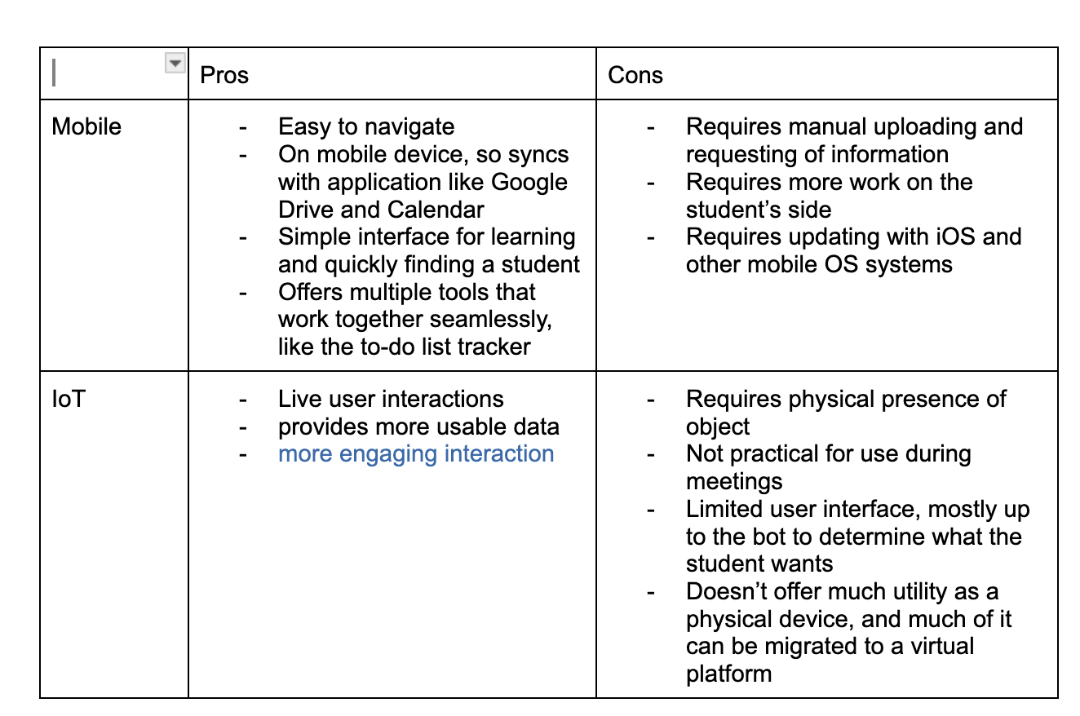
PROS/CONS TABLE:

Slide 41
FULL TESTING NOTES
（Doc added to drive）
https://docs.google.com/document/d/1KGOHknh7rPLcNxSzc9PuQz5bHM9QIPTnOgXm-vKRrlA/edit?usp=drive_link
SCRIPTS FOR TESTING
（Doc added to drive）
https://docs.google.com/document/d/1Uu8yzQNMfMcvyi95mRNQeT99zOsN3D7FjXo2iZMV6yA/edit?usp=drive_link

